Slide 1
Employee Data Analysis using Excel
STUDENT NAME: M. Gnanambika
REGISTER NO: 122203942 (8B02E9653BA907C9339408621CF0EA1A)
DEPARTMENT: B.Com(Corporate Secretaryship)
COLLEGE: R.B. Gothi Jain College For Women

Slide 2
PROJECT TITLE
Employee Performance Analysis using Excel

Slide 3


AGENDA
Problem Statement
Project Overview
End Users
Our Solution and Proposition
Dataset Description
Modelling Approach
Results and Discussion
Conclusion
3/21/2024 Annual Review

Slide 4

PROBLEM STATEMENT Employee performance is done to track the performance of business by employees which help to focus on the growth.
Notes:
Employee perf

Slide 5
The Organisation growth is fully based and focused on the employee performance and their individual growth too, by makes the best performer to get incentives, promotion and etc. and motivate the lower performer in effective manner by this Employee Performance Analysis.

Slide 6

PROJECT OVERVIEW
.
This Employee Performance Analysis is to focus on the overall growth of the organisation by the analysis of employees performance which leads the Business Development.

Slide 7
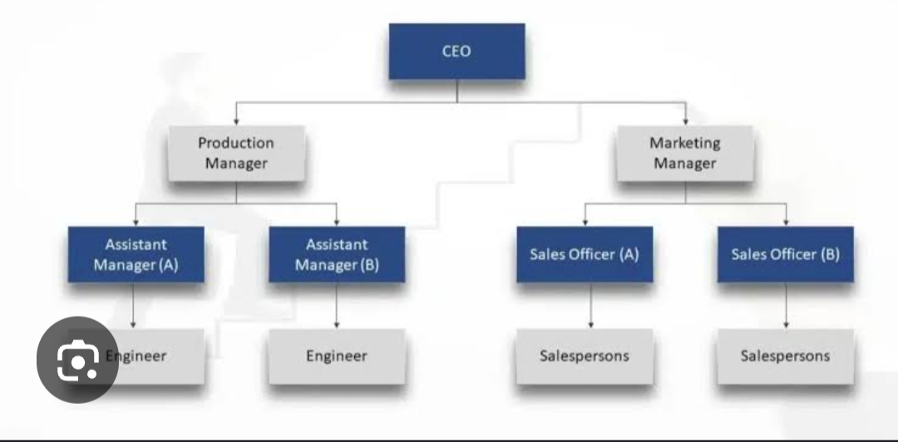

WHO ARE THE END USERS?

Slide 8

OUR SOLUTION AND ITS VALUE PROPOSITION . Conditional Formatting-Missing value Highlights Filter – Remove Formula – Performance Analysis Pivot Table – Summary of Analysis Slicer – Short Filteration of Data Graph – Data Visualization Trend Line – Line Visualization

Slide 9
Dataset Description Employee Dataset – Kaggle website Employee Performance Analysis – Edunet 26 – Features Data 9 – Features Data Selected Employee Id – Numeric value Employee Name, Employee Type, Performance Level - Text Gender – Male, Female Current Employee Rating – Numeric value

Slide 10

THE "WOW" IN OUR SOLUTION
=IFS(z8>=5,”VERY HIGH”,z8>=4,”HIGH”,z8=3,”MED”,”TRUE”,”LOW”)
* Is done to find the Current Employee Performance Rating in the Text basis by this formula.
3/21/2024 Annual Review
10

Slide 11
MODELLING
Data Collection:
1) Download from Kaggle website
2) Dataset from Edunet platform
Features Collection:
1) 26 features collected
2) 9 features selected
11

Slide 12
Data Cleaning:
1) Conditional formatting
2) Sort and Filter
Performance Level:
1) Employee performance rating
2) Current Employee Performance Rating
Summary:
1) Filter of 9 features
Visualization:
1) Pivot Table Graph Data Visualization
2) Slicer Filteration
3) Trend Line.

Slide 13
RESULTS
13

Slide 14
conclusion Comparing the performance of employee using excel shows the Medium performer of employee are very high and motivate them for effective outcomes and makes them to very high performer.

